Slide 1
Multi-Tenancy
Development, Challenges & Solutions.

Slide 2
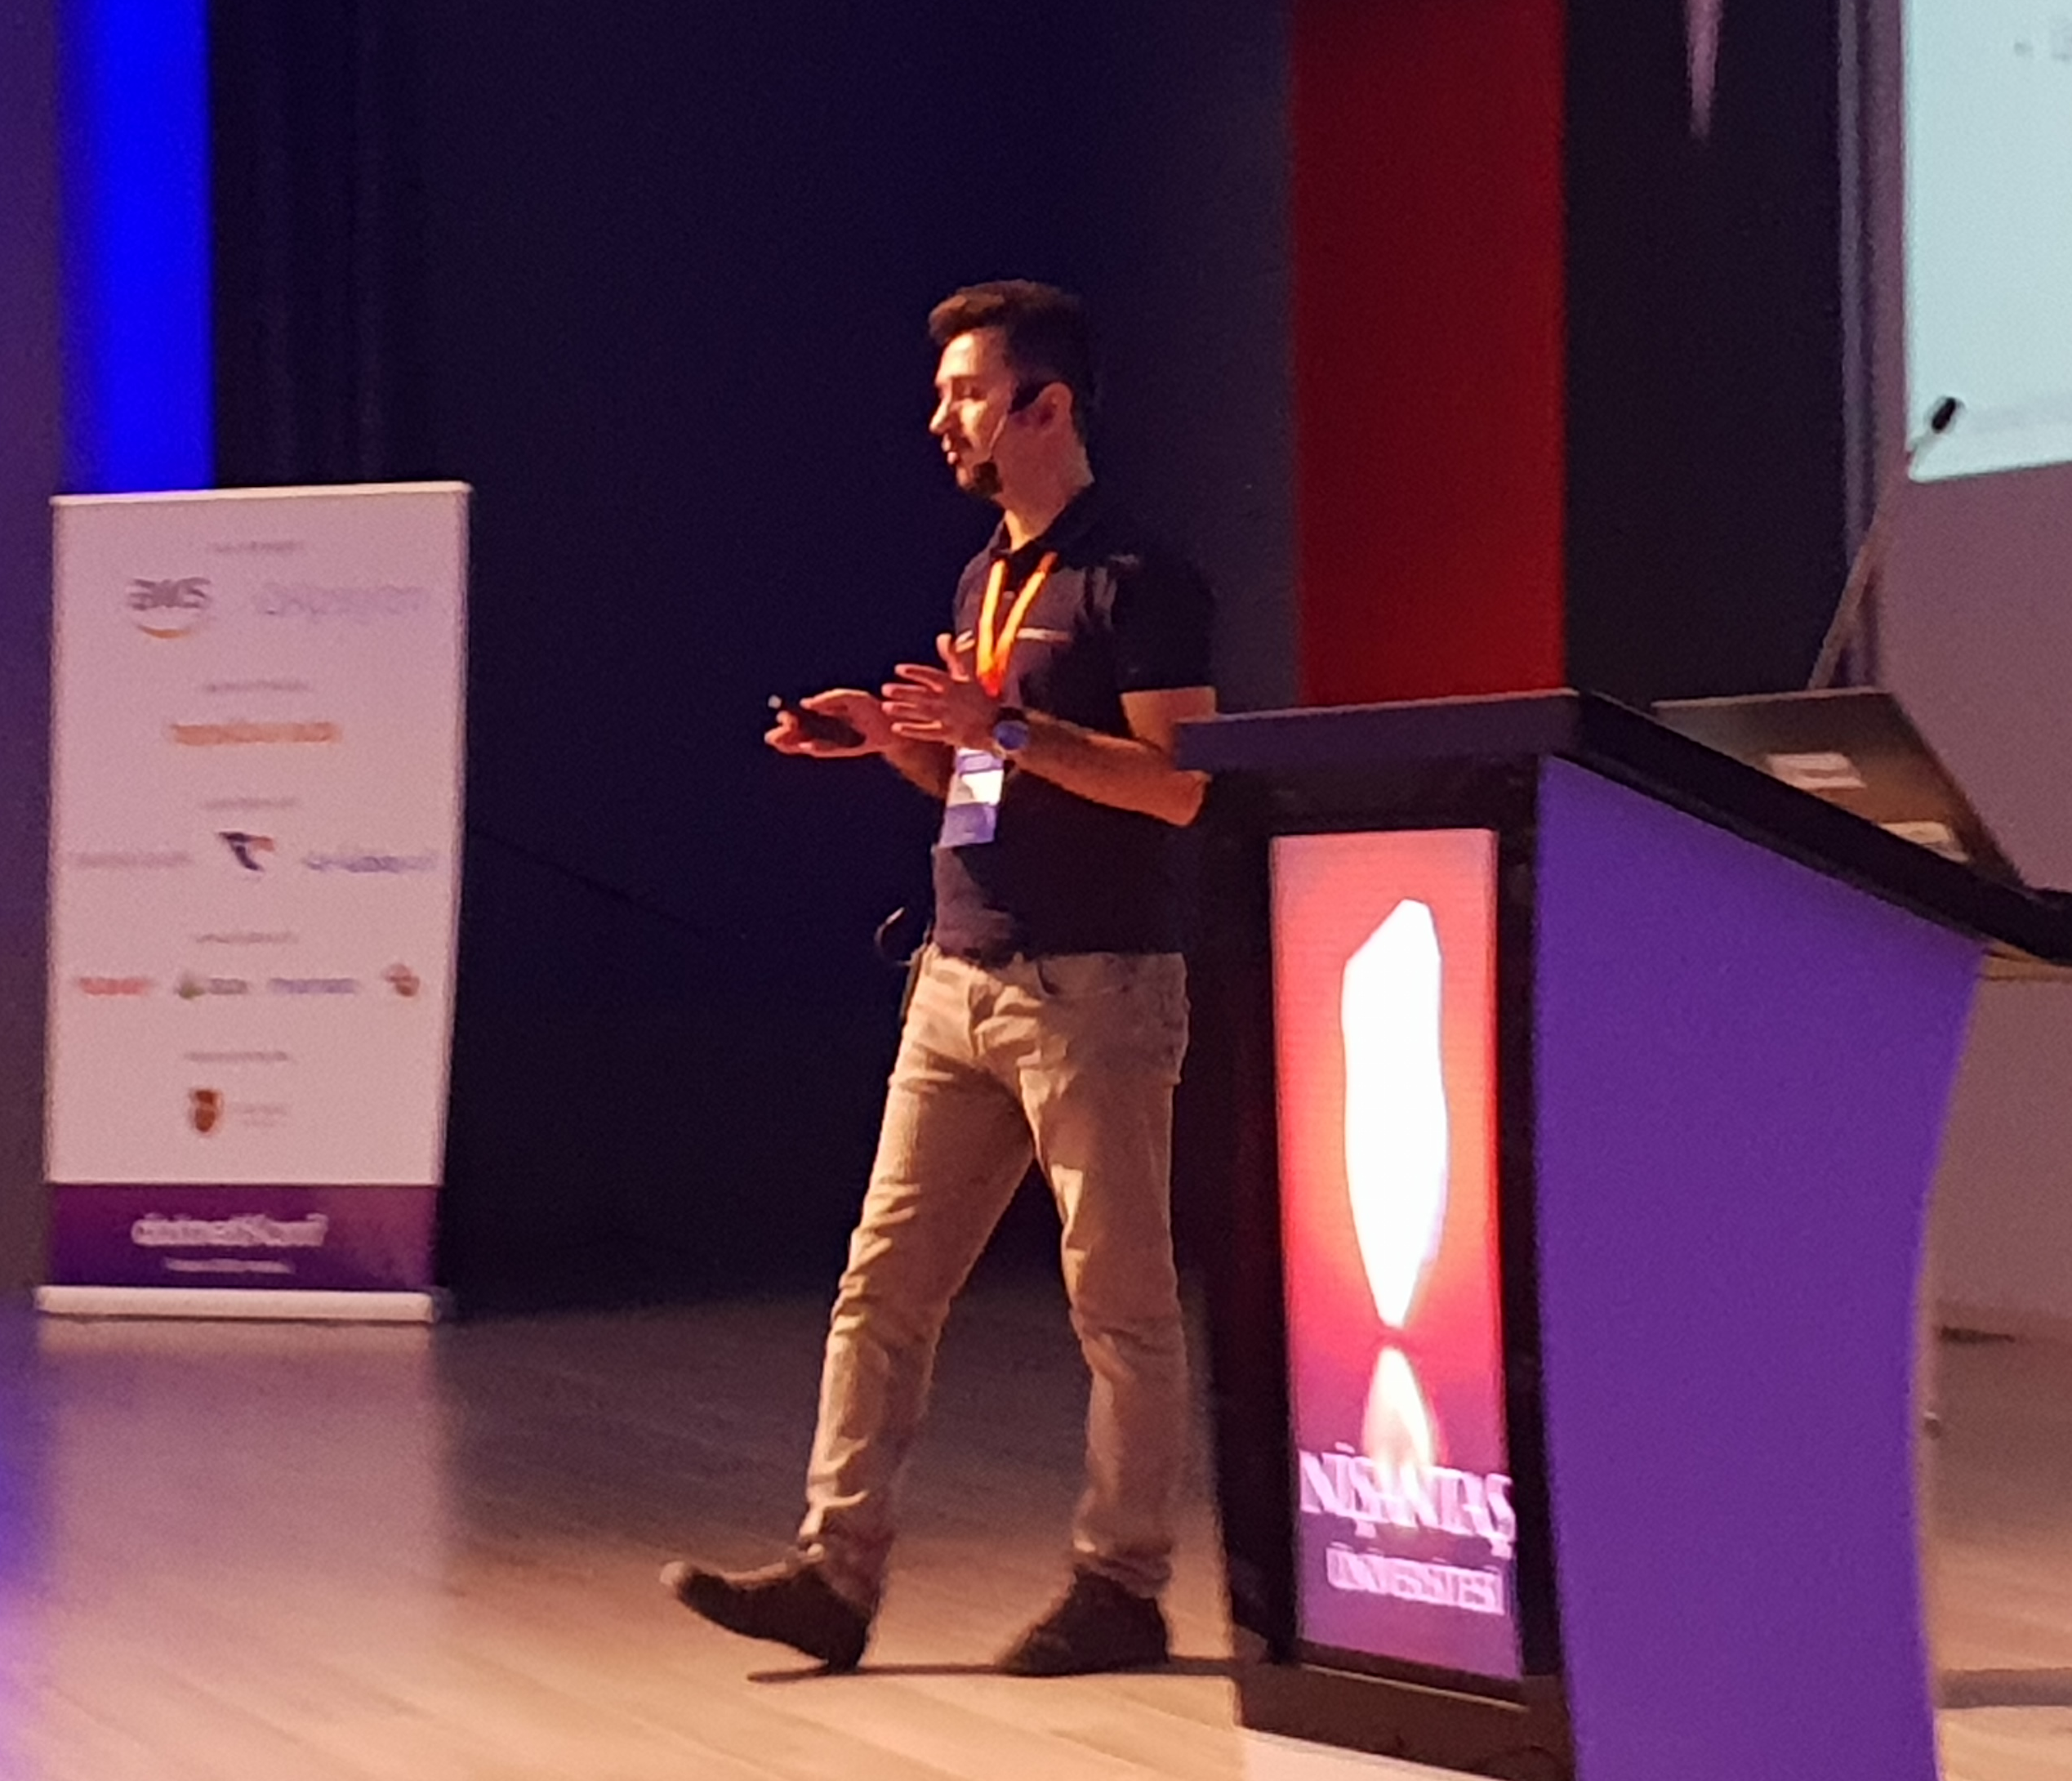
About Me
& My Company & My Projects

Slide 3

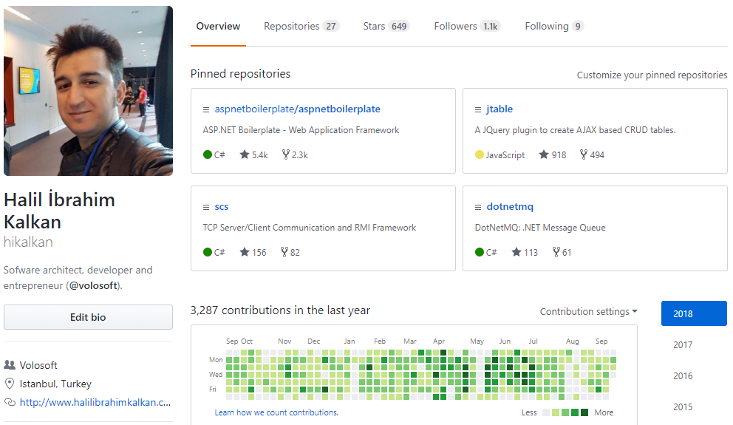
Halil İbrahim Kalkan
Github @hikalkan
Twitter @hibrahimkalkan
Email halil.kalkan@volosoft.com

Slide 4

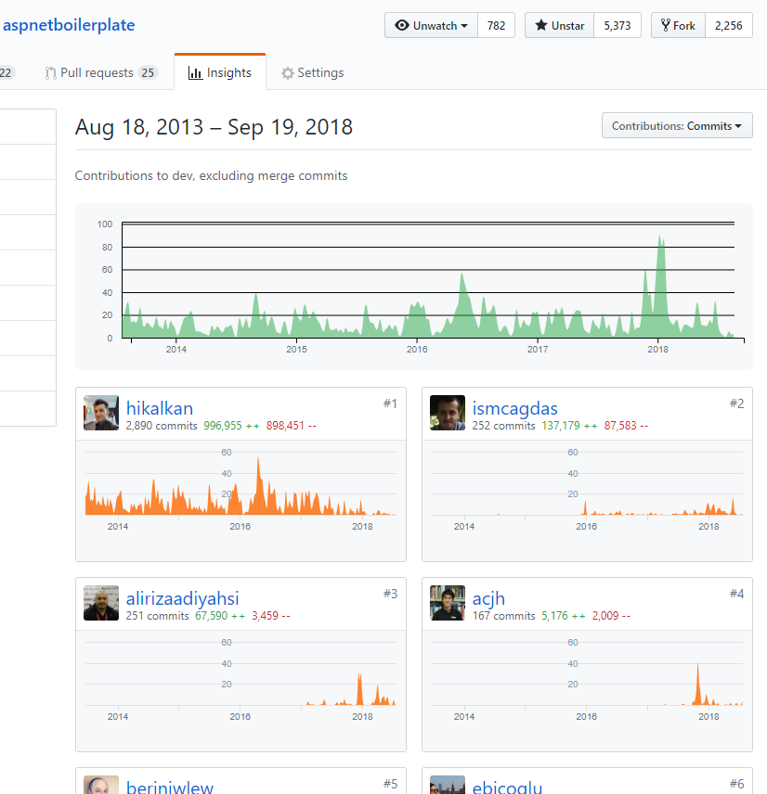
aspnetboilerplate.com
5+ years of continuous development.
5,500+ stars on GitHub.
700,000+ downloads on NuGet.

Slide 5
Agenda
SaaS, multi-tenancy, benefits & difficulties.
Multi-Tenancy: High level architecture / database separation.
How to determine & change the current tenant.
Implementing database & data isolation.
Temporarily enable/disable multi-tenancy.
Handling database migrations.
SaaS features and declarative feature check.
Summary

Slide 6

SaaS
Software as a Service

Slide 7
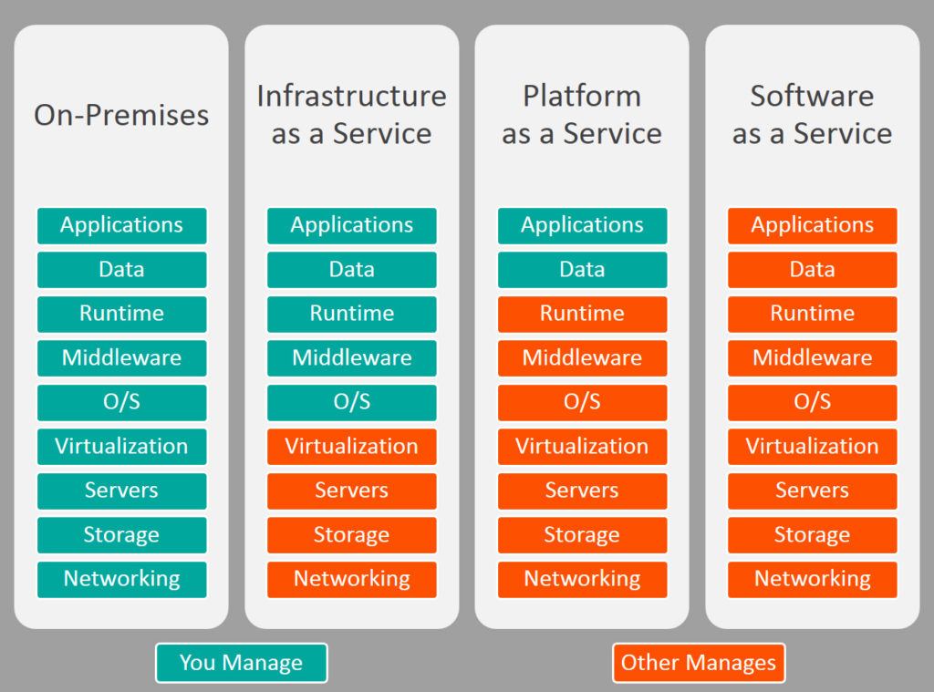


On-Premise / IaaS / PaaS / SaaS

Slide 8
SaaS Concepts
Tenant: An organization that uses the application/service (and pay for it).
Host: The organization that is responsible to provide the service and manage all the tenants.

Slide 9

Why Multi-Tenancy?
Maximum Utilization / Low Costs.
Easy to add a new client (tenant).
All clients use the same application & version.
Easier maintenance & upgrade.

Slide 10

Difficulties
Data Isolation.
Performance: One tenant’s heavy usage may effect the other tenants.
Different client requirements, configuration & customization.
Security.
Backup (per tenant)

Slide 11

Multi-Tenancy
High-Level Architecture

Slide 12
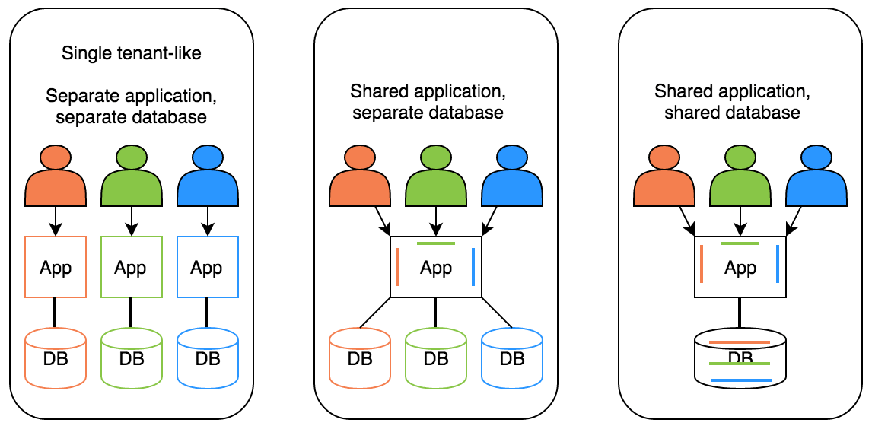
Deployment / Database Options
Hybrid!

Slide 13
Ideal Multi-Tenant Application
Works exactly like on-premise: Separated users, permissions, data…
Should be able to work as on-premise too.
Should be developed independent from multi-tenancy. Multi-tenancy should be implemented in the infrastructure/framework.

Slide 14
Stateless Application Design
Application should be stateless!
Main state origins:
Http Request: Cookie, header, querystring, payload…
Authentication Ticket
Database: Relational, non-relational, file system…
Cache: Distributed caches like Redis, Memcached.

Slide 15

Multi-Tenancy
Determine the Current Tenant

Slide 16
Determine the Current Tenant
Sources
Current Claims (if user has been authenticated)
Subdomain (or domain): https://tenancy-name.mydomain.com
Http Header: _tenant = “acme” (for API clients & SPAs)
Http Cookie: _tenant = “acme” (for MVC applications)

Slide 17
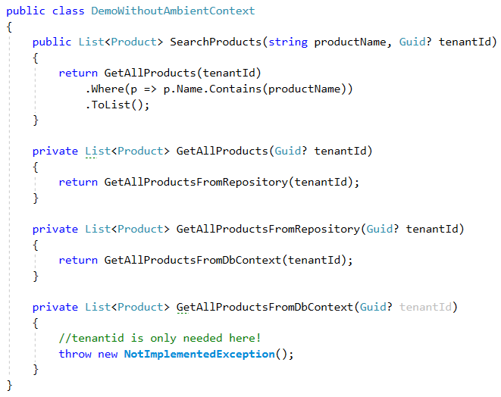
Ambient Context Pattern (without it)

Slide 18
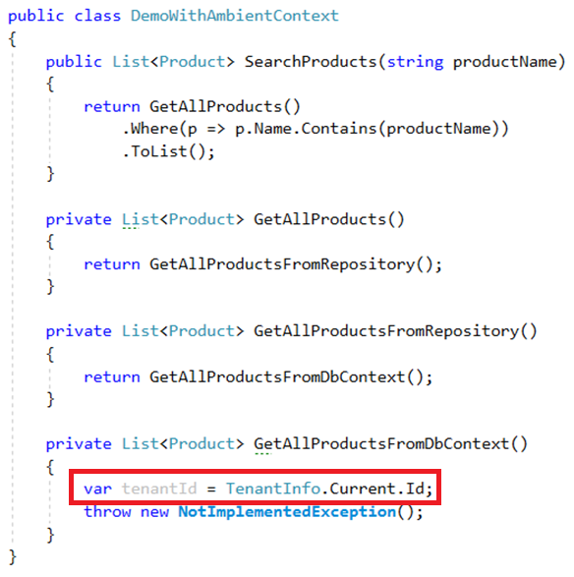
Ambient Context Pattern

Slide 19
Ambient Context Examples
HttpContext.Current / ASP.NET Core: IHttpContextAccessor.HttpContext
CultureInfo.CurrentUICulture / Thread.CurrentThread.CurrentUICulture
Thread.CurrentPrincipal

Slide 20
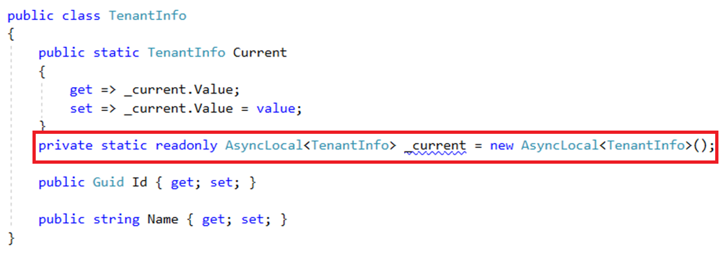
Implementation using AsyncLocal<T>

Slide 21
AsyncLocal<T> Alternatives
Public static … Multi-threading problem!
HttpContext.Items: Web-depended!
ThreadStatic / ThreadLocal<T>: Not async/await friendly!

Slide 22
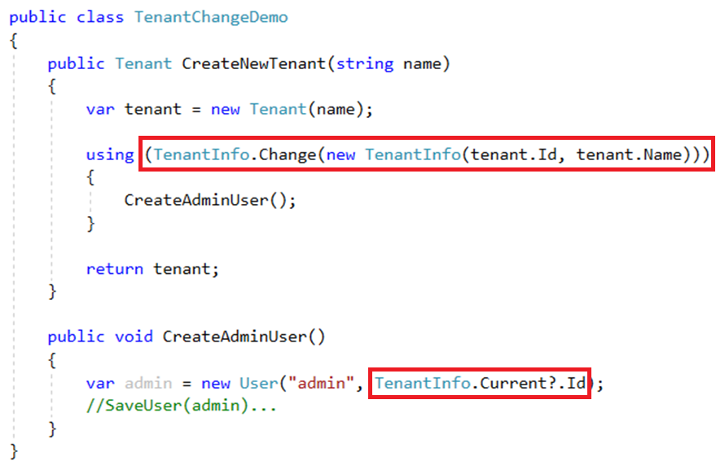
Change Current Tenant

Slide 23
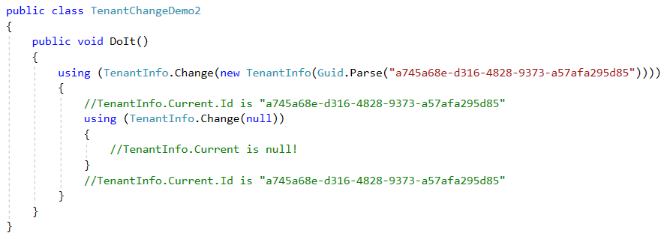
Change Current Tenant (Nested)

Slide 24
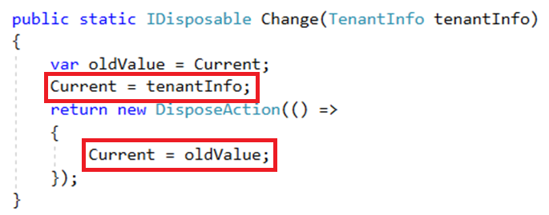
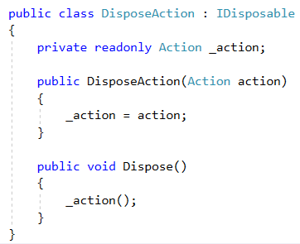
Change Current Tenant

Slide 25
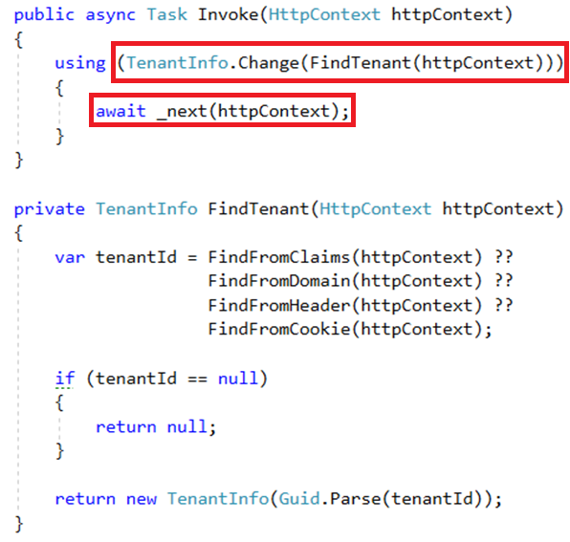
Multi-Tenancy Middleware Implementation

Slide 26
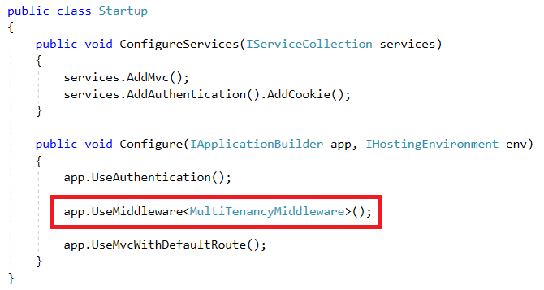
ASP.NET Core Multi-Tenancy Middleware

Slide 27
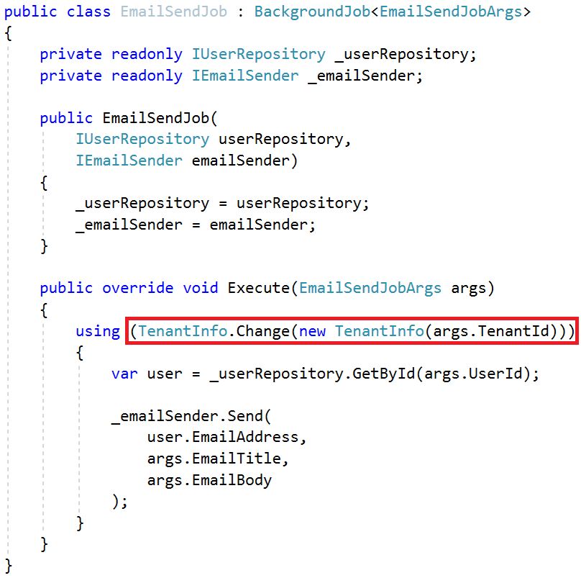
Change Tenant in a Background Job

Slide 28

Multi-Tenancy
Database / Data Isolation

Slide 29
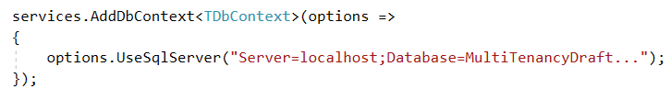
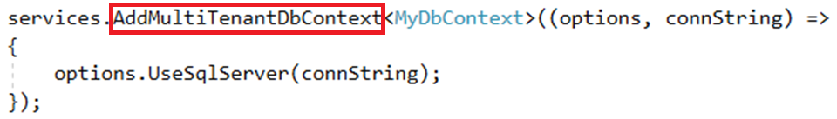
Dynamically Select the Connection String

Slide 30
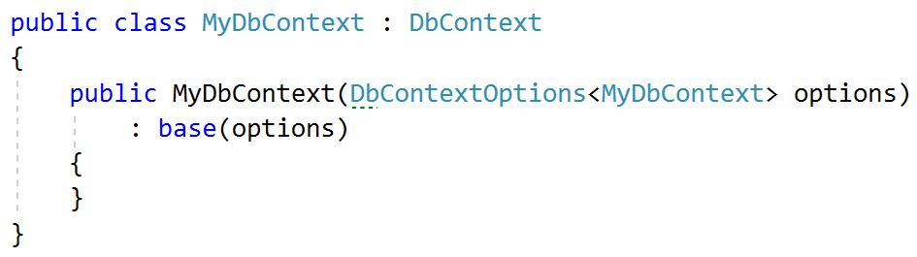
Dynamically Select the Connection String

Slide 31
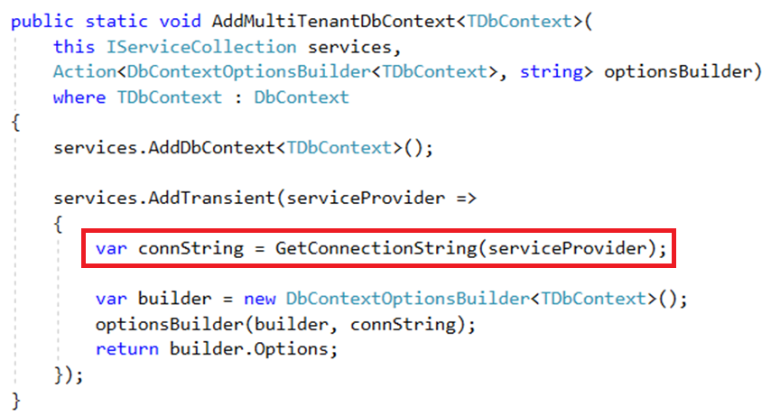
Dynamically Select the Connection String

Slide 32
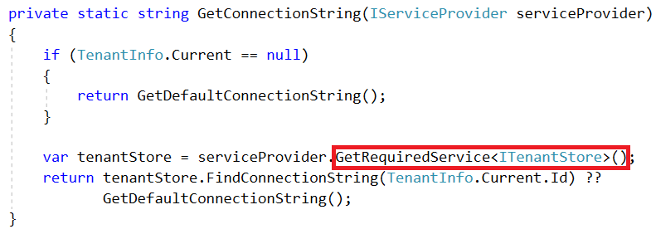
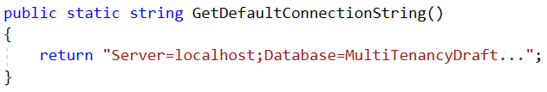
Dynamically Select the Connection String

Slide 33
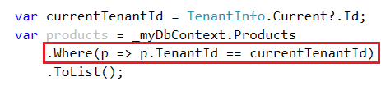
Data Filtering: Manual Way

Slide 34
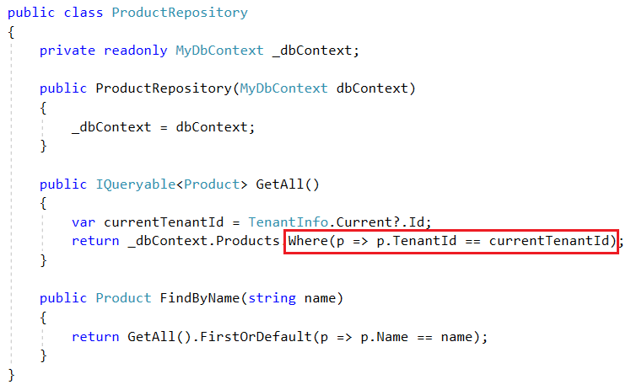
Automatic Data Filtering: Repository Pattern

Slide 35
Automatic Data Filtering: Repository Pattern
Pros
Easy to implement (especially using generic repository pattern - IRepository<TEntity>).
ORM Independent (can be implemented for any ORM that supports IQueryable).
Central data-access
Cons
Limited – Can be bypassed by directly using DbContext.
Limited – Does not work for navigation properties.
Open to leak (Repository developer may forget it).

Slide 36
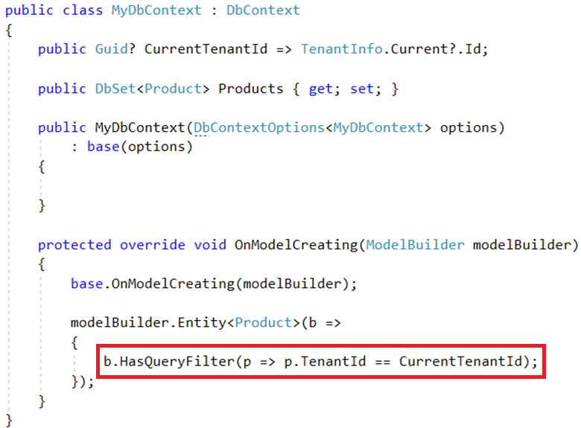
Automatic Data Filtering: EF Core Global Filters

Slide 37
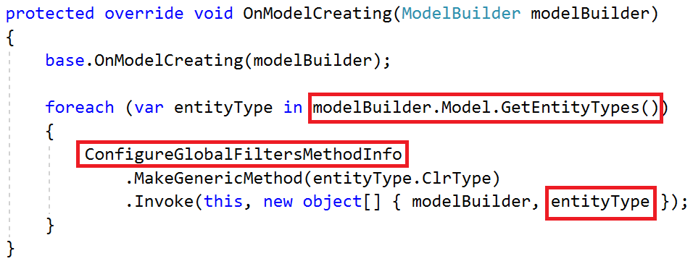
Automatic Data Filtering: EF Core Global Filters

Slide 38
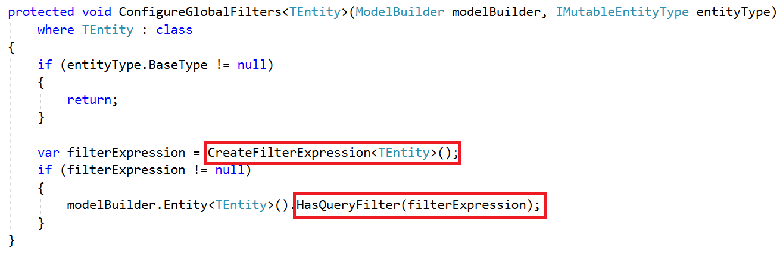
Automatic Data Filtering: EF Core Global Filters

Slide 39
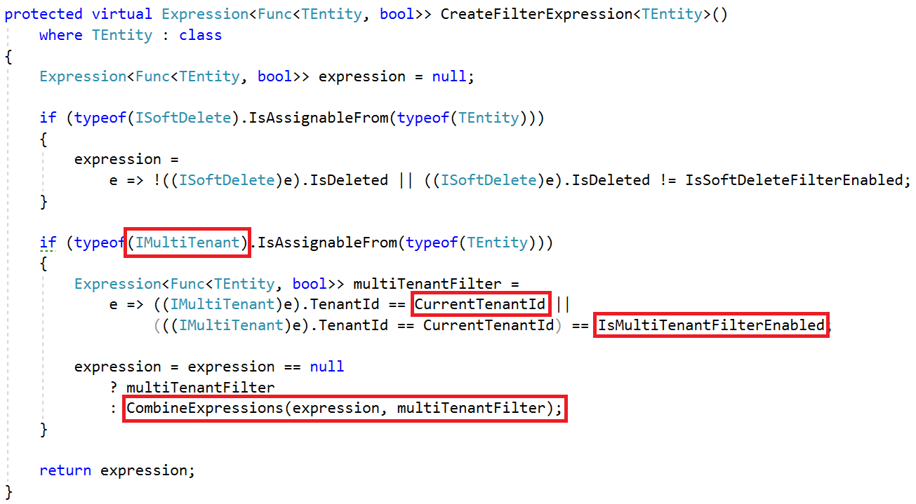
Automatic Data Filtering: EF Core Global Filters

Slide 40
Automatic Data Filtering: EF Core Global Filters
Pros
Natively works with EF Core.
Supports navigation properties as well.
Cons
Limited – does not support multiple filters and enable/disable individually (possible via workarounds – may be directly supported in the future).
Limited – Does not work if you directly work with SQL, stored procedures… etc.
Not available for all ORMs and data access APIs (but available for EF Core, NHibernate and even for EF 6.x)

Slide 41
Automatic Data Filtering: Other Options
Row Level Security – Available for SQL Server and Azure SQL Database.
Pros: Completely integrated to DBMS. Works for everything.
Cons: Relatively complex to implement. Specific to DBMS.
Azure Elastic Database Pool
Pros: Dynamically create databases per tenant. Easily scale.
Cons: Only for db per tenant scenario. Has it’s own API. Has limitations.

Slide 42
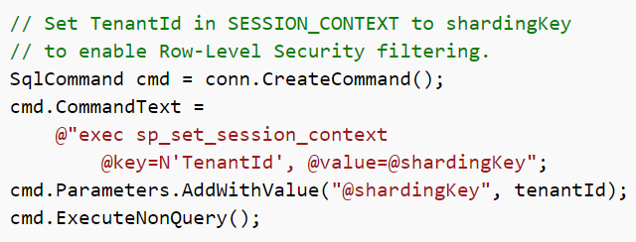
Automatic Data Filtering: Row Level Security
Set Session Context while changing the current tenant:

Slide 43
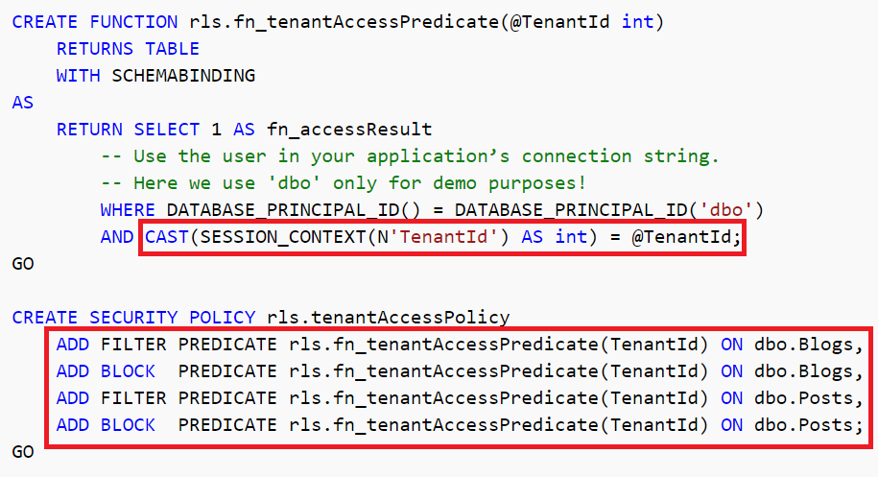
Automatic Data Filtering: Row Level Security
Create a policy to filter/block data

Slide 44
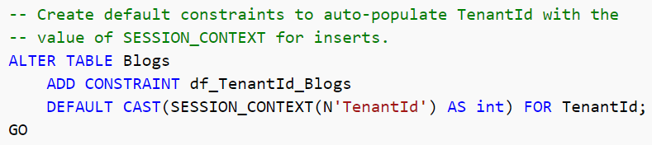
Automatic Data Filtering: Row Level Security
Automatically set TenantId for new entities

Slide 45
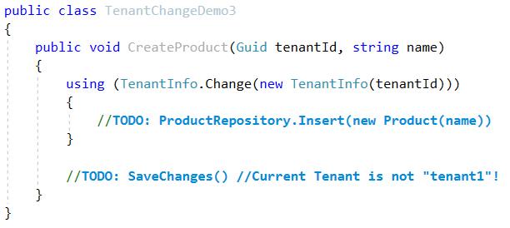
Setting Tenant Id for New Entities
In DbContext.SaveChanges()
Get new entities for change tracker, find IMultiTenant entities, set current TenantId.
Problem: May set wrong tenantId.

Slide 46
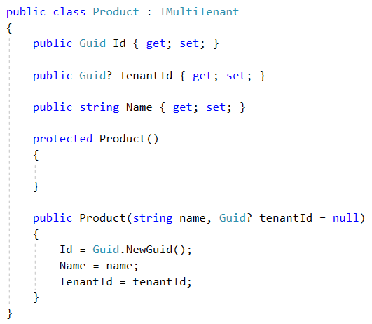
Setting Tenant Id for New Entities

Slide 47
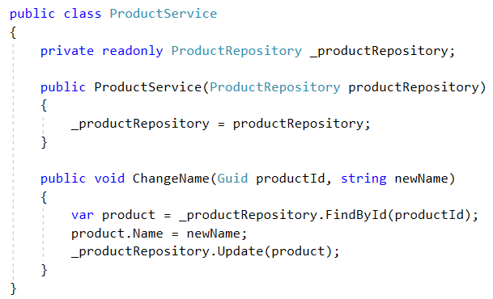
Safe Way to Manipulate Data

Slide 48
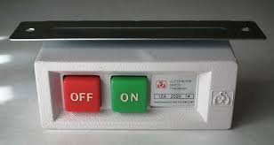
Multi-Tenancy
Enable/Disable

Slide 49
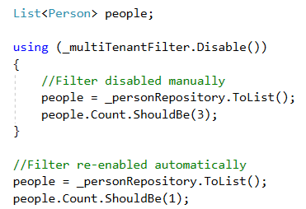
Disable/Enable By Scope
May need to query on all tenants.
Can be implemented using ambient context pattern.
Problem: Not easy for multi-database scenario.

Slide 50

Multi-Tenancy
Database Migrations

Slide 51
Schema / Data Migration
Problem for multiple-databases.
Solution: Upgrade all in one with a custom tool.
Pros: Easy to implement. All tenants are in the same version.
Cons: May get too long time for big number of tenants and data. All tenants wait for all upgrade progress.
Solution: Upgrade the application servers immediately, upgrade databases individually on first access.
Pros: Upgrading is distributed to time. A tenant does not wait for another.
Cons: First accessing user may wait too much. Even we get timeout exception. Also, we don’t control the upgrade speed.

Slide 52
Schema / Data Migration
Solution: Multiple versions concurrently.
Split the application servers into two parts: Upgraded tenants use the new application, other tenants use the old application.
Pros:
Minimum waiting for every tenant.
Upgrading may be scheduled for every individual tenant and they can be informed.
Allows us to perform A/B tests and previews.
Cons
Requires multiple application servers – but reasonable for a big system.
Harder to implement, maintain and monitor.

Slide 53
Multi-Tenancy
SaaS Features

Slide 54
Feature / Package / Subscription System
Define features of the application. Feature Types:
On/Off: Excel export, Replying by email (for a support app)…
Numeric:10 users, 20,000 emails/month…
Selection: one of the available options.
Group features into packages/editions.
Subscribe packages by tenants.
Check features: Declarative or by code

Slide 55
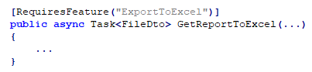
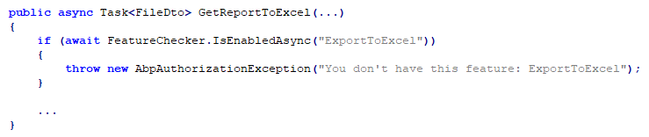
Feature Checking

Slide 56
Declarative Feature Check Implementation Options
MVC Action Filters
Easy to implement. Naturally works within ASP.NET Core.
Limited to Controller actions.
Method Interception using dynamic proxying (interception).
Works everywhere.
Limited to virtual methods.
Weaving: Mono.Cecil, Fody, Postsharp… etc.

Slide 57
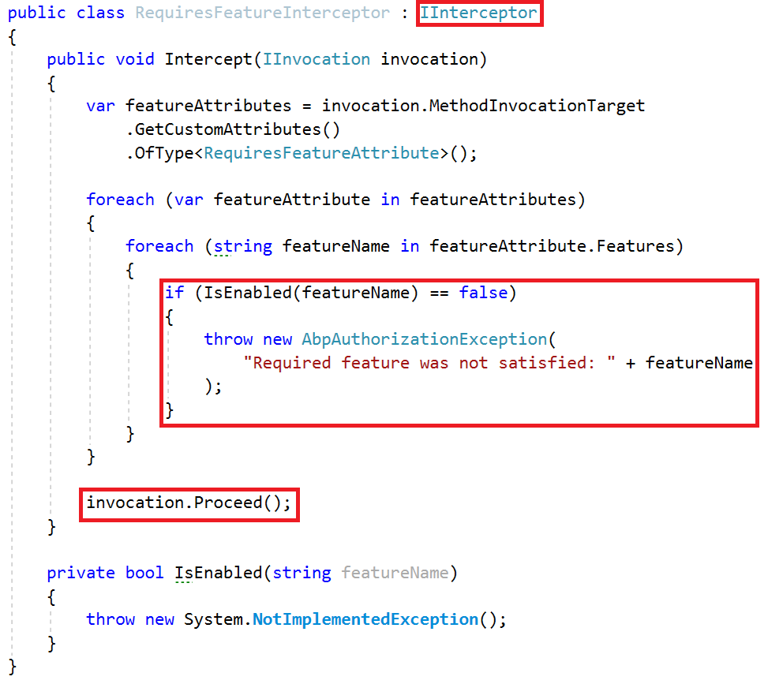
Declarative Feature Check: Interception

Slide 58
Multi-Tenancy
Summary

Slide 59
Summary
What is SaaS & Multi-Tenancy? Tenant v.s. Host.
Benefits: Maximum Utilization, easy to maintain.
Difficulties: Isolation, Performance, Customization, Security, Backup (per tenant).
Database Options: DB per tenant, single DB, Hybrid
Ideal Multi-Tenant & Stateless Application Design
Determine the current tenant
Sources to obtain current tenant
Ambient context pattern & AsyncLocal
Change the current tenant

Slide 60
Summary
ASP.NET Core Multi-tenancy Middleware
Dynamically Select the Connection String
Automatically Filtering Tenant Data
EF Core Global Query Filters
SQL Server Row Level Security
Safe way to insert and update entities
Disable/Enable multi-tenancy
Database migrations
SaaS Features & Dynamic Proxying

Slide 61
Thank you…
Github @hikalkan
Twitter @hibrahimkalkan
Email halil.kalkan@volosoft.com
Halil İbrahim Kalkan

